Slide 1
Latent Growth Modeling
Byrne Chapter 11

Slide 2
Latent Growth Modeling
Measuring change over repeated time measurements
Gives you more information than a repeated measures test – even if you use a linear post hoc analysis.

Slide 3
Latent Growth Modeling
Advantages:
Estimate means and covariances separately
Estimating observed values and unobserved values separately
You can’t really get the unobserved in RM

Slide 4
Assumptions
Continuous measurement of the DVs
This assumption is true for all of SEM though.
Time spacing is the same across people
NOT across measurements, but people need to be spaced the same

Slide 5
Assumptions
At least three time points per person
(otherwise it’s a dependent t-test)
Larger samples (N>200)

Slide 6
Dual-Layered Model
Level 1 = within person change across time
Similar idea as repeated measures
Level 2 = between person changes
Similar idea as between subjects

Slide 7
Before you start…
You have to know the expected type of change before you start
Generally it’s linear (hence linear growth models)
But it can be curvilinear or power functions, etc.

Slide 8
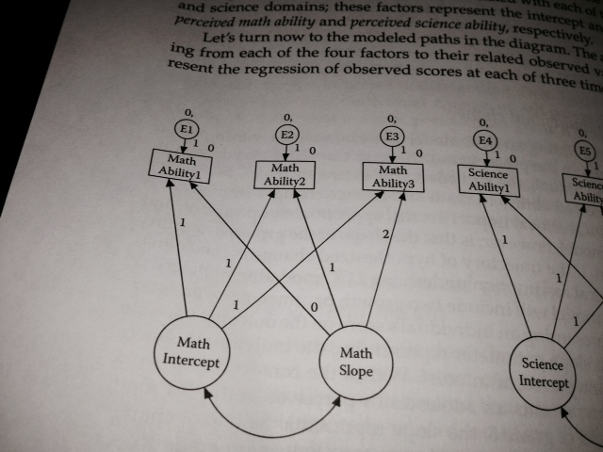

Slide 9
Linear Models
Intercept
You set these values to 1 indicating that you do NOT want to estimate them
Basically that gives you a starting value for the first time point … the average point where people start, which is the y-intercept.

Slide 10
Linear Models
Slope – represents the change over time
You can set these values to anything you want
Usually the first time is indicated by a 0
There’s no slope for time 1, just an intercept
Then the paths are set based on the time differences between them

Slide 11
Linear Models
Setting the parameters this way:
Helps with identification
Is theoretical to match the concept of slope and intercept estimation
Allows you to not have to set the variances, so you can look at them.

Slide 12
Level 1
For within subject change, you check out the measurement model
Basically, you are setting the covariance structure to a very specific set up, so that you can measure level 2

Slide 13
Level 1
That’s why knowing what type of model to use (linear, curvilinear) is important this step
Because you set the variables to specific numbers, the output is not useful at this step

Slide 14
Level 2
Look at the structural part of the model (the latents)
Examining the mean structures of intercept and slope
Examining the variances associated with those latents

Slide 15
Level 2
Intercept mean = the average starting point for time 1
Slope mean = the average increment across time points

Slide 16
Level 2
Intercept variance = the spread around the average start point
Large scores indicate a lot of spread – meaning people start in a lot of different places
Small scores indicate a small spread – everyone starts about the same place

Slide 17
Level 2
Slope variance – the range of increments across time points
Small variances mean that everyone is going up/down about the same amount
Large variances mean that people scores are going up/down differently (almost like an interaction)

Slide 18
Level 2
Factor covariance – examines the relationship between intercept and slope
If you have a positive covariance – people who start higher go up faster
(high intercepts are tied to high slopes)
Remember this interpretation is based on if the slope is positive or negative

Slide 19
Level 2
Factor covariance – examines the relationship between intercept and slope
If you have a negative covariance – people who start higher go up slower
(high intercepts are tied to low slopes)
Remember this interpretation is based on if the slope is positive or negative

Slide 20
A side note
Don’t use the plug in. It crashes every time. It’s dumb.

Slide 21
The set up
You make the intercept and slope latent variables
Fix the intercepts to 1 and the slopes to 0, 1, 2
You are setting the intercepts to fixed to be equal across times (it’s one regression equation)
Remember that you can change the slope values based on their time set up

Slide 22
The set up
Turn on estimate means and intercepts
Make sure you get the 0 next to the squares for the mean
Make sure you get NO 0,Var next to the intercept and slope
You want to estimate the mean and variance!

Slide 23
Let’s try it!
Open the growth spss file to get going.

